Slide 1
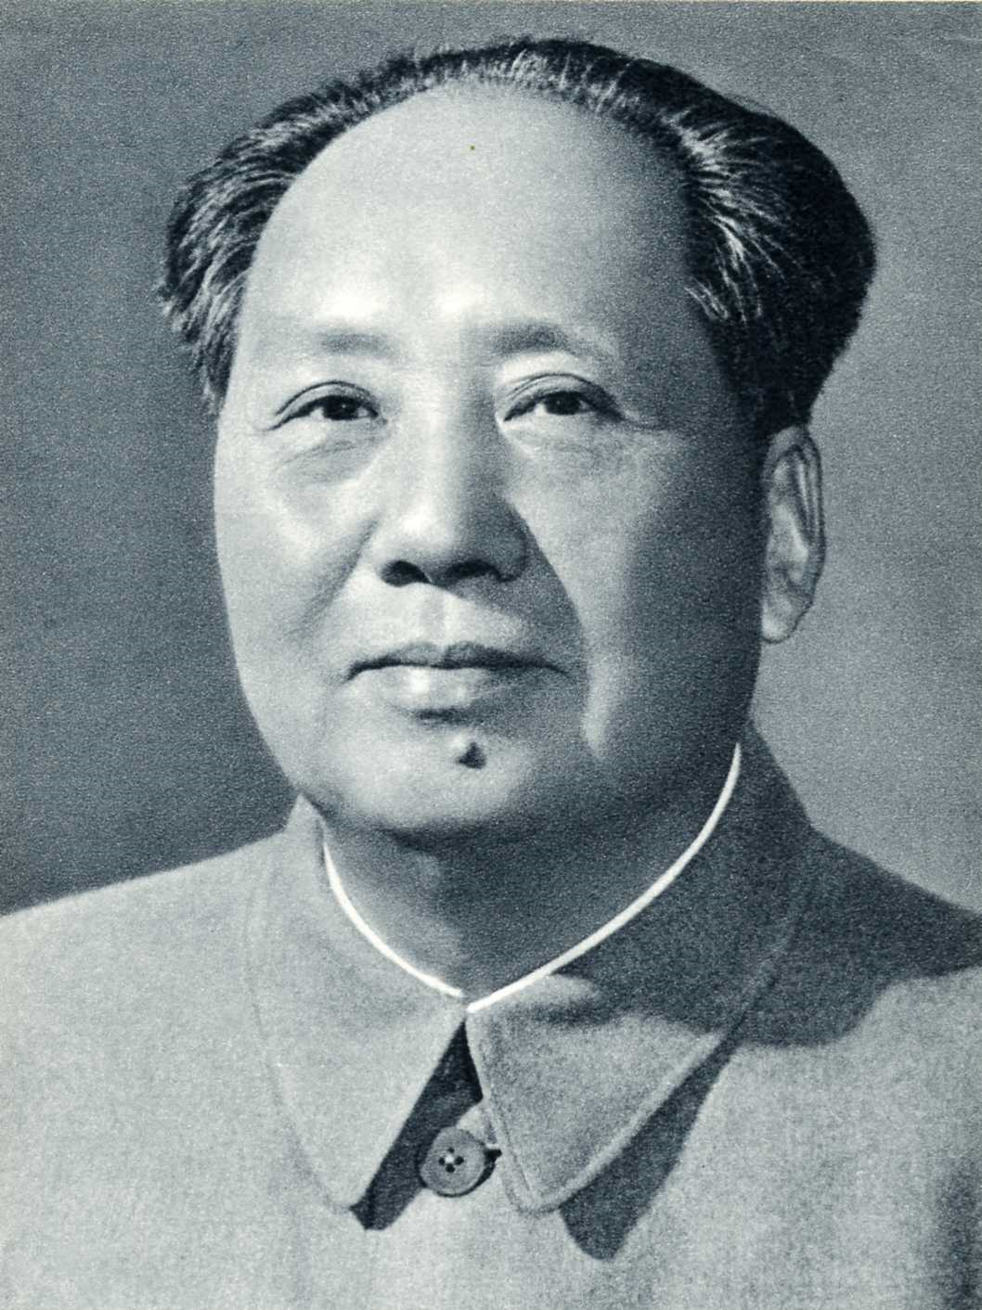
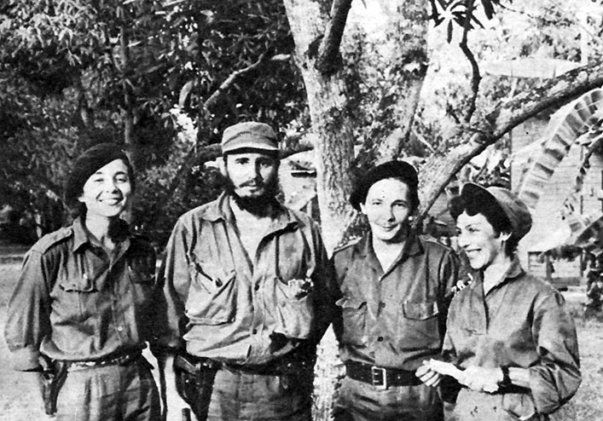
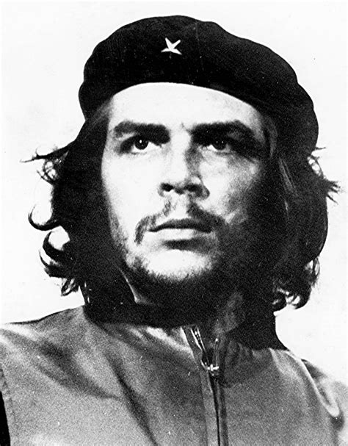
Third Worldism

Slide 2
This lecture
(1) US and Soviet policies toward the Third World
(2) Survey of decolonizing countries
(3) Third World Internationalism

Slide 3
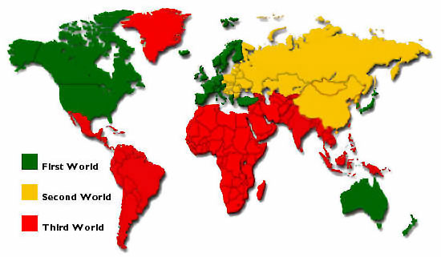
Part One: The Third World in the Cold War

Slide 4
Idea of Convergence
US- New Deal developed new state capacities to regulate the control of the market domestically. This looked a lot like Soviet “planned economy,” especially during World War Two
USSR- After Popular Front, Soviet Union veered to the right at least in turn of its revolutionary rhetoric
US and USSR are wartime allies during World War Two, against the “common enemy”

Slide 5
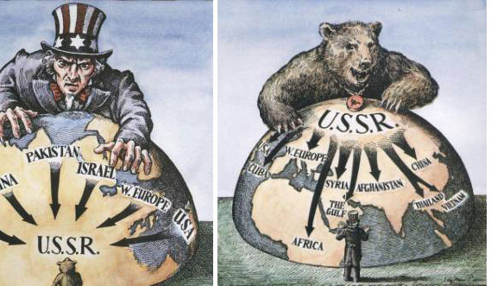
Why a Cold War?: Bipolar Power Structure
“Structural Realist” IR Theory- what matters is the structure of states in the international system
Based on rational actor assumption, states have narrow range of possible choices
Bipolar structure creates “security dilemma,” defense of one side looks like aggression to the other

Slide 6
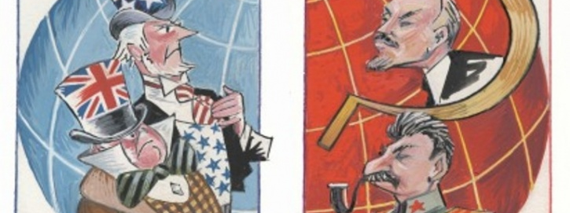
Why a Cold War?: Irreconcilable Political Economic Systems
Ideologies
Political goals
Economic systems

Slide 7
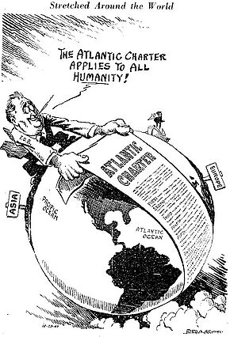
Globalizing the Four Freedoms
Roosevelt and Churchill drafted the Atlantic Charter 14 August 1941
Big Three plus China signed Declaration of United Nations 1 January 1942
UN established 1945, after the war
Principles:
Self-determination
Collective security
Develop institutions for international trade and finance

Slide 8
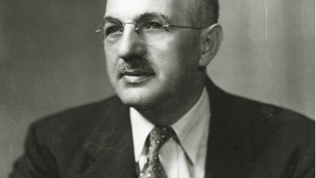
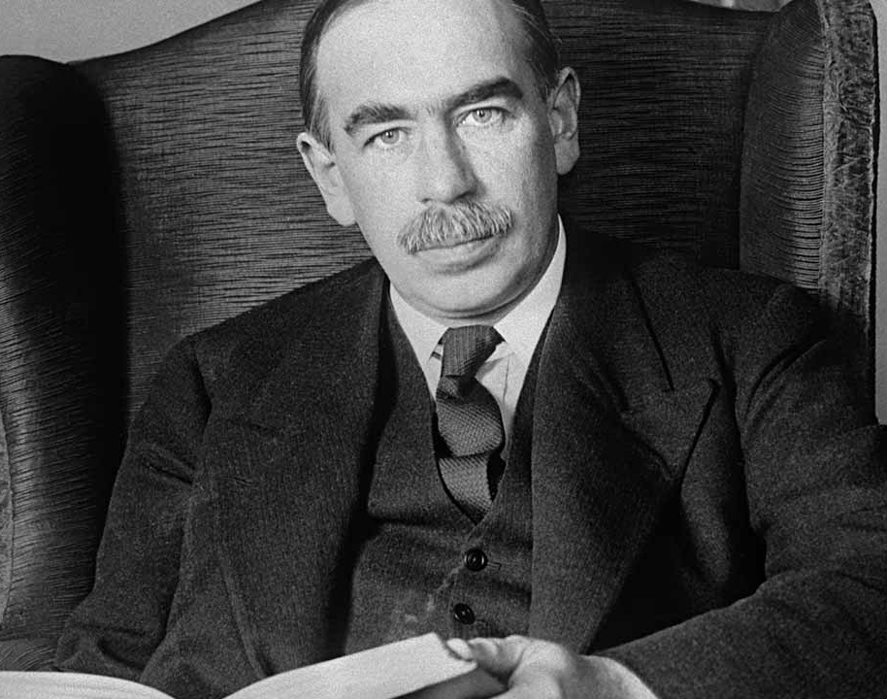
Bretton Woods
Conference 1944 laid out plans for a liberal (capitalist) postwar trade order
Bretton Woods Institutions:
GATT/WTO
International Monetary Fund
World Bank
Harry Dexter White- New Deal, sympathetic to the Soviet Union
John Maynard Keynes- Institutionalist economist, hostile to Soviet Union

Slide 9
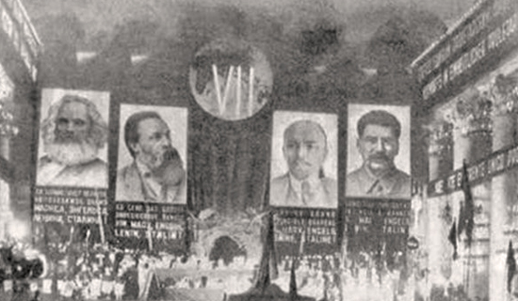
Evolution of Stalinist Colonial Policy
Exercised through control over national Communist Parties
1920s to 1935- oscillated between “united fronts” with progressives and absolute political independence of proletariat/peasantry
1935 “Popular Front” changed course, after which policy would always be some version of participation in coalitions with bourgeois nationalist parties

Slide 10
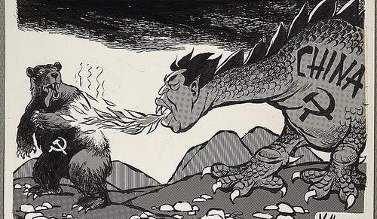
Sino-Soviet Split, 1957-1966
De-Stalinization campaign pressed for “peaceful coexistence” under threat of MAD
Mao Zedong called US “Paper Tiger”
Implication: Press harder for anti-colonial revolutions to destabilize capitalist sphere
Despite split, by 1960s both prescribed pretty much the same strategy for the Third World

Slide 11
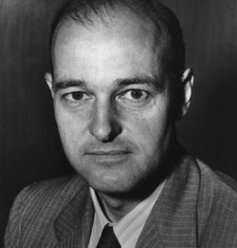
Western View
Soviet Union and affiliated Communist Parties= worldwide conspiracy for global domination
George Frost Kennan/Mr. X “Long Telegram” Soviet diplomatic goals were both Marxist and grounded in Russian nationalism
Inverted the narrative of imperialism

Slide 12
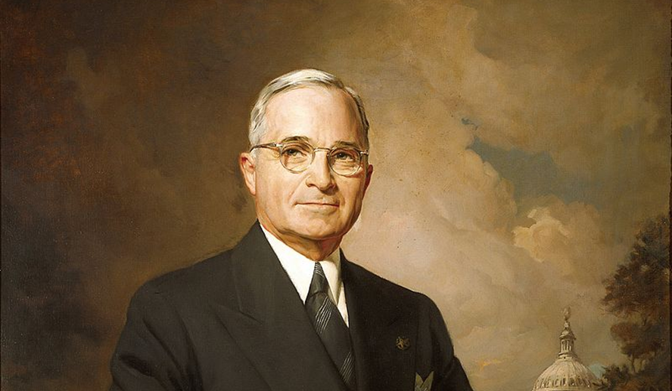
The Policy of Containment
Premise: Communism is a spreading disease
Policy: Stop its spread through aid and force
Truman Doctrine, March 1947
Heavily influenced by Mr. X
Established NATO
Included “Point Four,” idea of economic aid to underdeveloped world

Slide 13
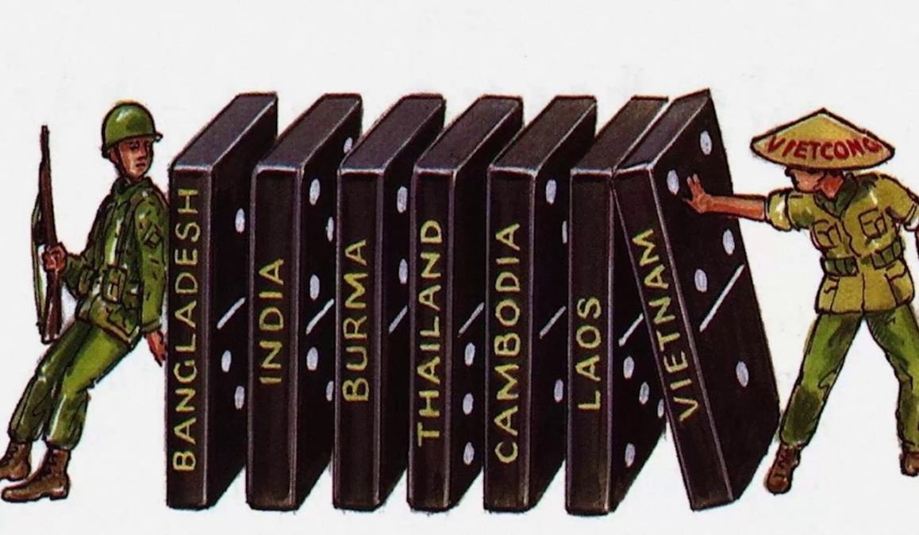
Domino Theory and Proxy Wars
If one state falls, others will follow

Slide 14
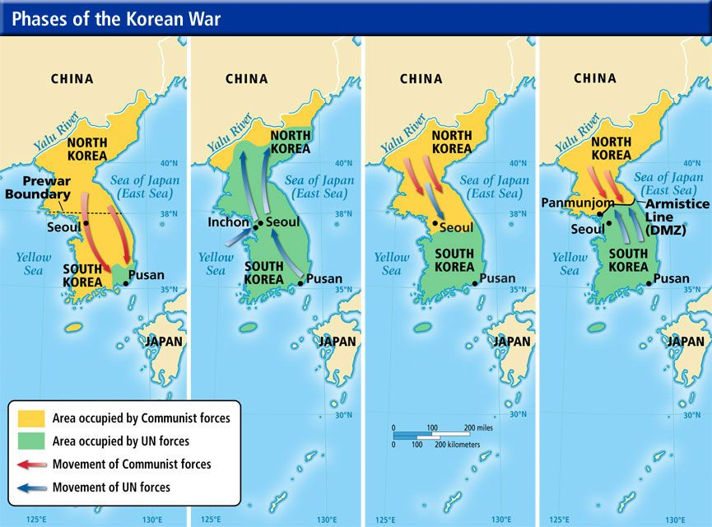
First “Proxy War”: Korea, 1950-1954

Slide 15
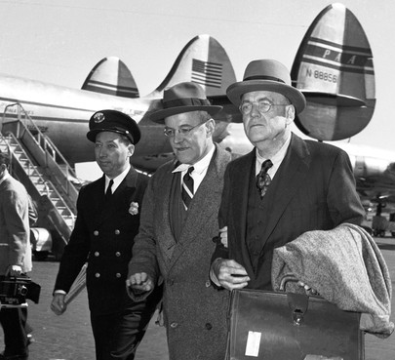
CIA-Backed Coups: The Stick of Containment
Allen and John Foster Dulles

Slide 16
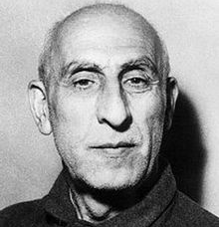
Mohammed Mosaddegh
Democratically-elected prime minister
Iranian nationalist
Not a Communist, though Communist Party (Tudeh) was part of the coalition that formed his government
Secular leader, popular among the working classes, opposed by clerics and monarchists
Threatened to expropriate British Anglo-Iranian Oil

Slide 17
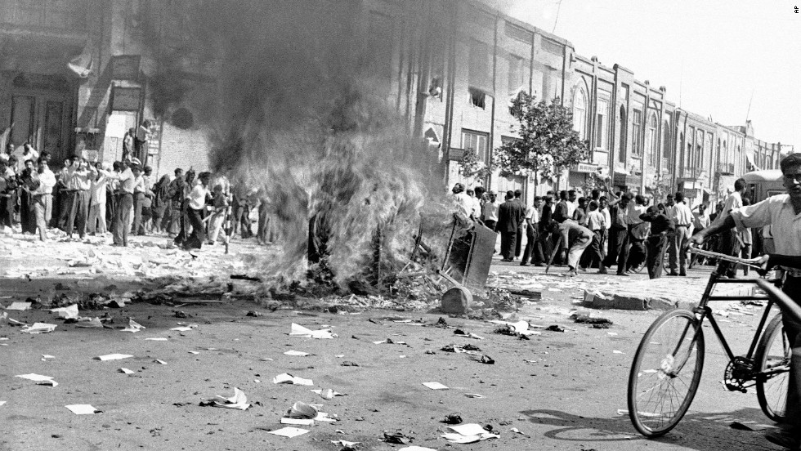
Operation Ajax
Organized by Dulles brothers, with Eisenhower’s approval
CIA channeled funds to protest groups
Orchestrated on the ground by Kermit Roosevelt Jr. (grandson of TR)

Slide 18
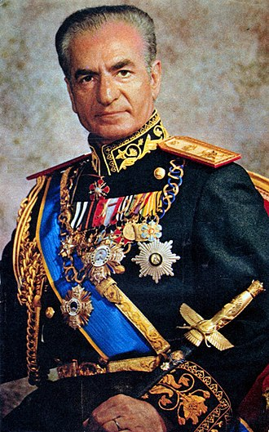
Shah Mahammad Reza Pahlavi
Though formally a democracy, power effectively resided with the Shah
U.S. oil syndicate forced Anglo-Iranian to cut them in
Shah couldn’t shake appearance of subservience to Washington, eventually fell to religious nationalists

Slide 19
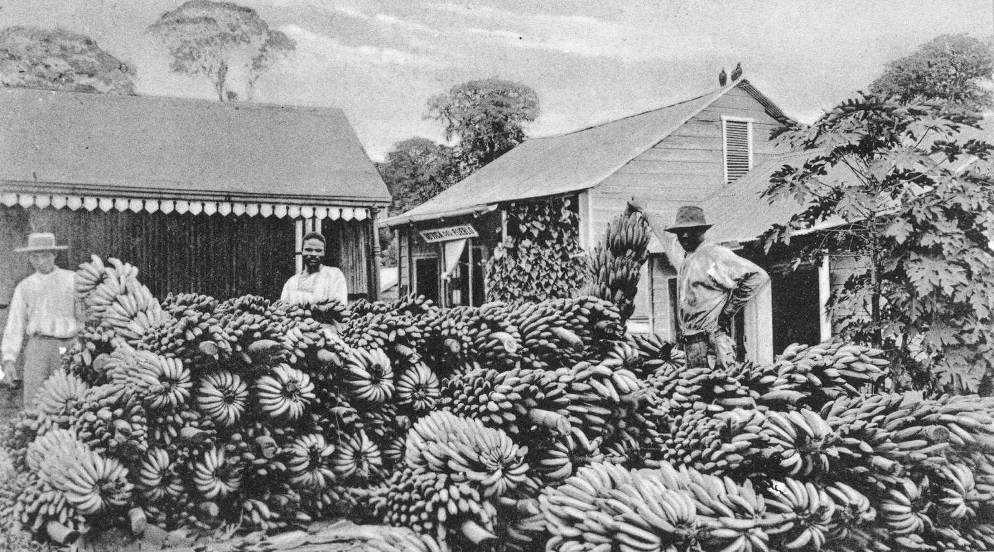
United Fruit’s Banana Republic

Slide 20
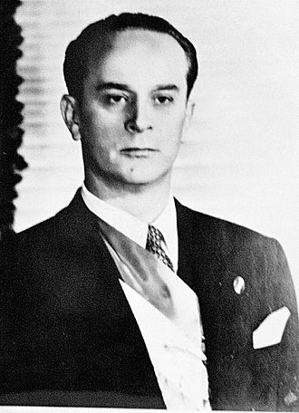
Jacobo Arbenz
Democratically elected president in 1954
Not a Communist
Proposed seizing UFC land and redistributing to poor Indians (think forty acres and a mule, changing what must be changed)

Slide 21
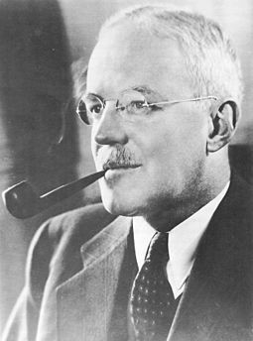
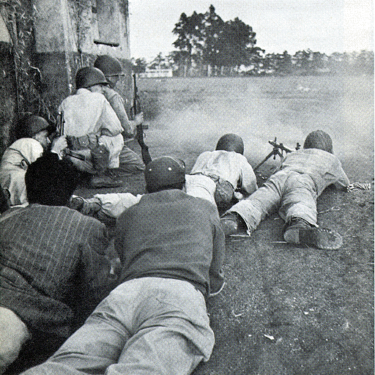
Operation PBSUCCESS
Dulles brothers had professional ties to UFC
U.S. provided military training to Guatemalan expatriates, including Carlos Castillo Armas
CIA led invasion and overthrow of Arbenz

Slide 22
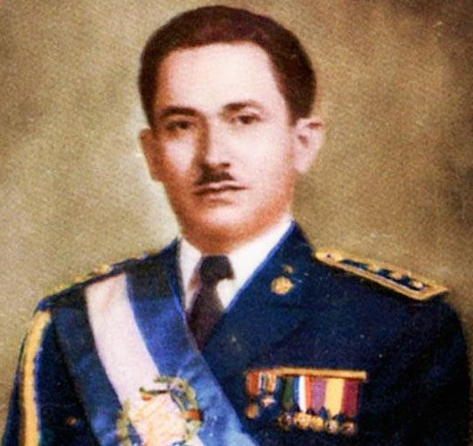
Carlos Castillo Armas
In power through a coup
Authoritarian
Ruled through brutal repression
Did not expropriate United Fruit

Slide 23
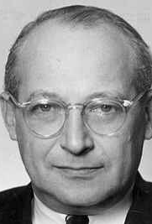
Modernization Theory: The Carrot of Containment
Academic theory, spurred by Cold War-fueled growth of higher education
Premised on “stages of growth,” culminating in U.S.-style liberal democracy
U.S. funds and technocrats oversaw ambitious economic, social, and cultural modernization projects

Slide 24
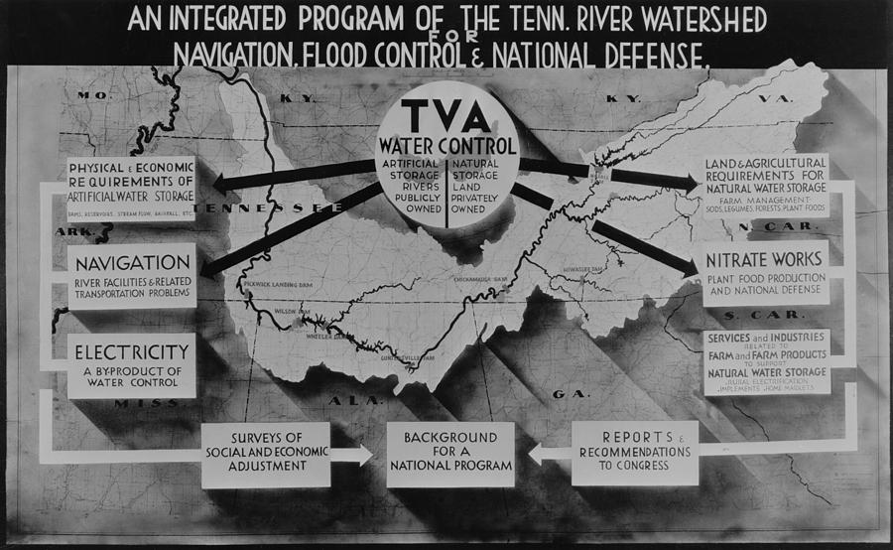
The Tennessee Valley Authority (TVA)
Public/Private corporation
Government orchestrated, comprehensive rural “Modernization” project, first of its kind
Goals: Electrification, fertilization, agricultural modernization, employment, education
Most symbolic example of “convergence”

Slide 25
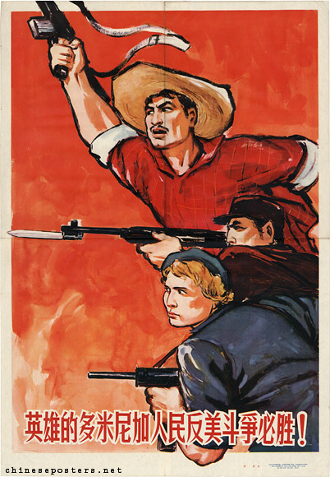
Part Two: National Liberation Movements

Slide 26
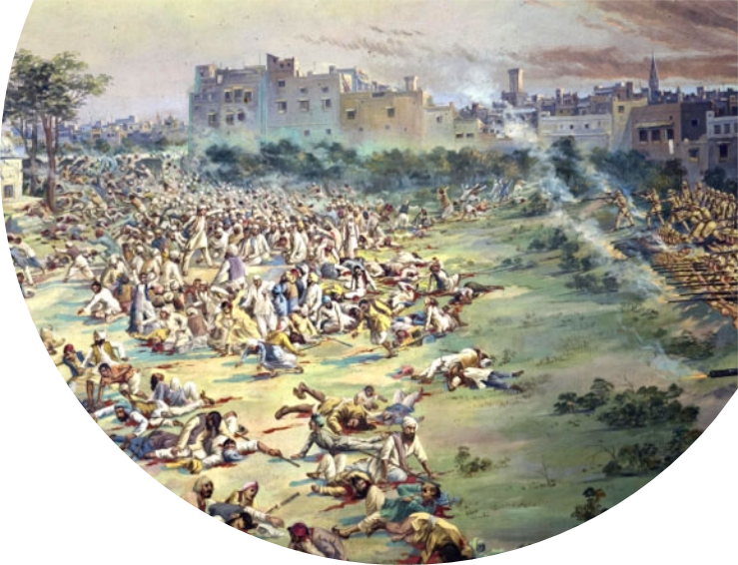
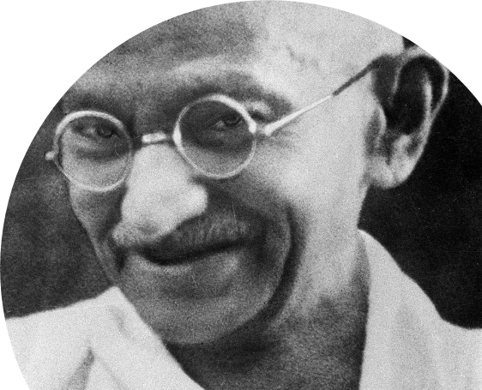
India: Recap
Nationalism surged with 1905 partition of Bengal
Indian National Congress espoused self-rule position by the end of WWI
Britain cracked down hard, with Anarchy and Revolutionary Crimes Act of 1919 and Amritsar Massacre

Slide 27
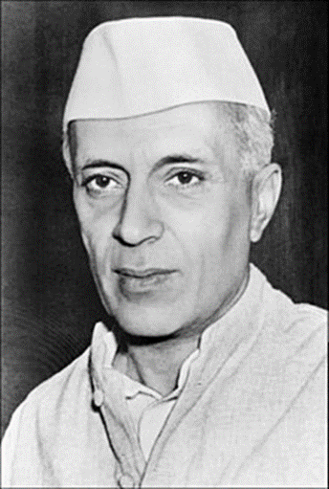
Indian Independence Movement
1920-1922- Non-cooperation movement called for peaceful protests against institutions and infrastructure of British Raj
Mid 1920s national liberation forces proliferated and fractured between religious, liberal/nationalist, and socialist/communist/anti-imperialist tendencies
Indian National Congress elected to local and provincial government positions on a platform of complete self-rule in 1937
Quit India Movement in 1942 led to
Partition and Independence of India and Pakistan, 1947
Nehru regime accepted aid from both US and USSR, pursued “mixed economy” regime

Slide 28
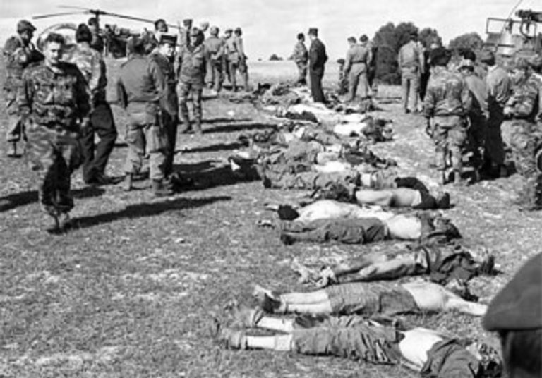
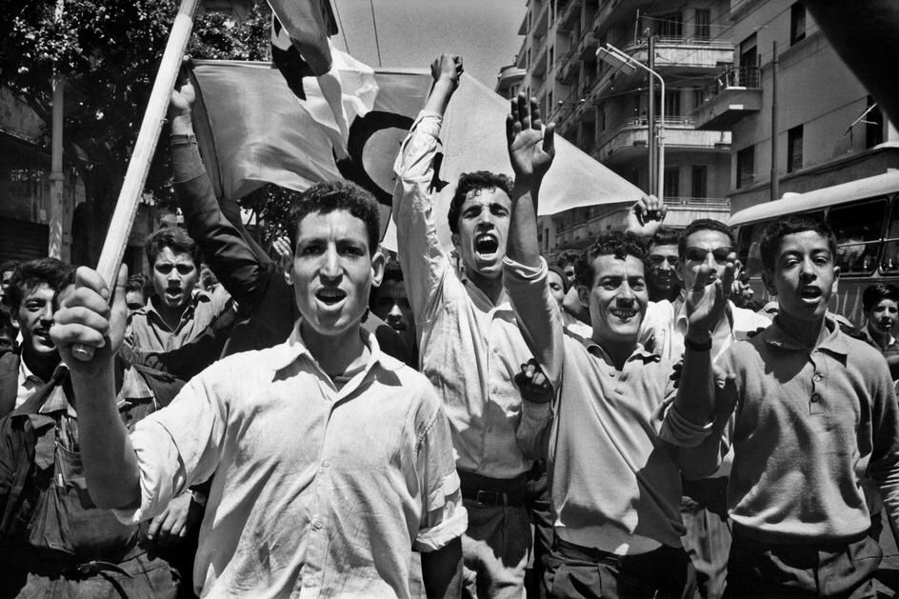
Algeria
Sétif massacre, 8 May 1945 (Armistice Day)
FLN (National Liberation Front) employed methods of guerilla warfare with massive popular support

Slide 29
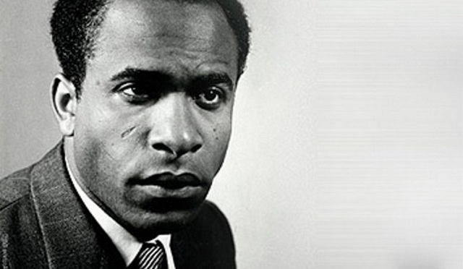
Fanon and the Algerian War
Martinique-born French psychiatrist working in Algiers when the revolution entered the city
Threw his support behind the FLN
Advocates violence as a psychological act, crucial for social cohesion
Warned against limitations of bureaucratic concentration

Slide 30
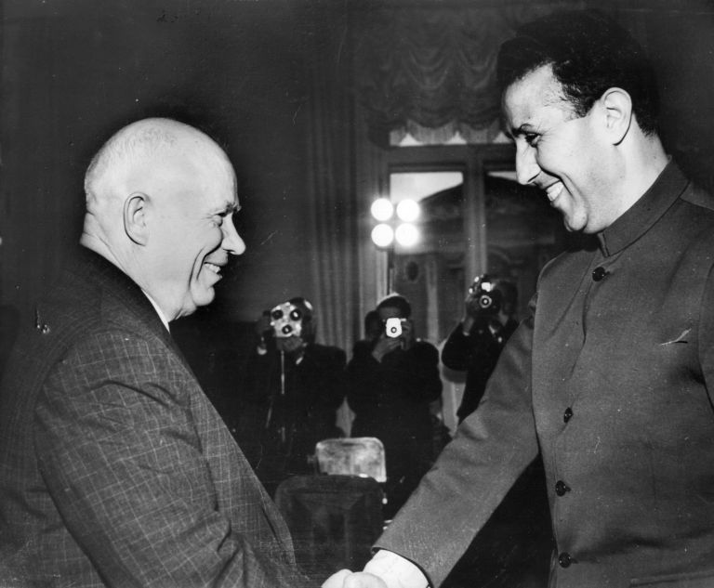
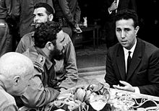
FLN in Power
Political and economic modernization in the absence of French bureaucracy fell to the organ of revolutionary nationalism
Tension arose between “autogestion” (self-management) and the prominence of the military bureaucracy

Slide 31
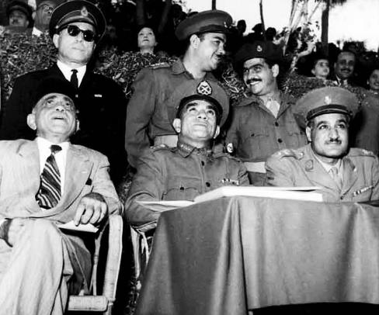
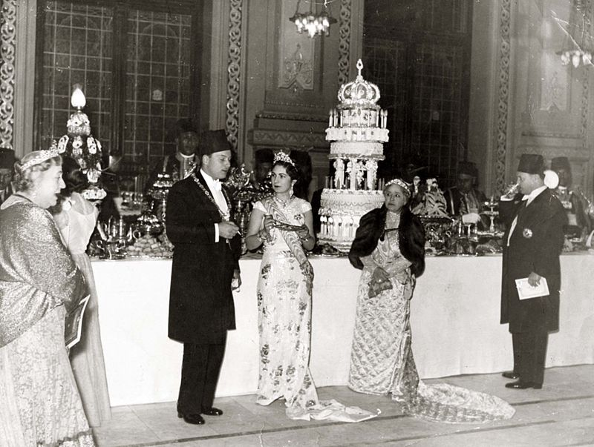
Egypt
Britain retained private ownership and control of strategically important Suez Canal and political influence through monarchy under King Farouk
Coalition of liberal nationalists, Communists, and Muslims united behind “Association of Free Officers” led by Nasser
Overthrew the monarch in a coup in 1952
Nasser pioneered “Arab Socialism”

Slide 32
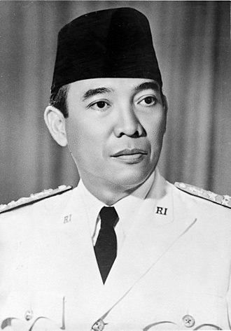
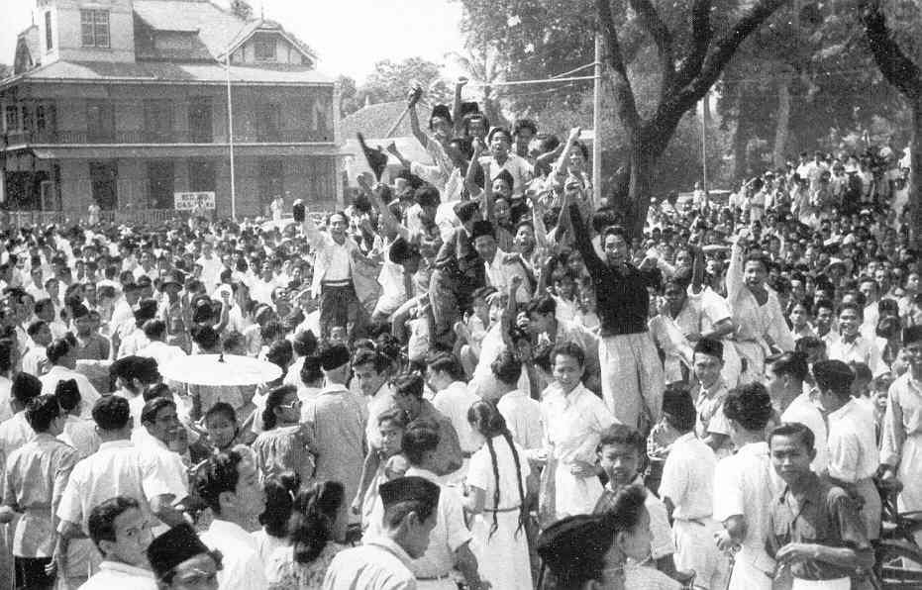
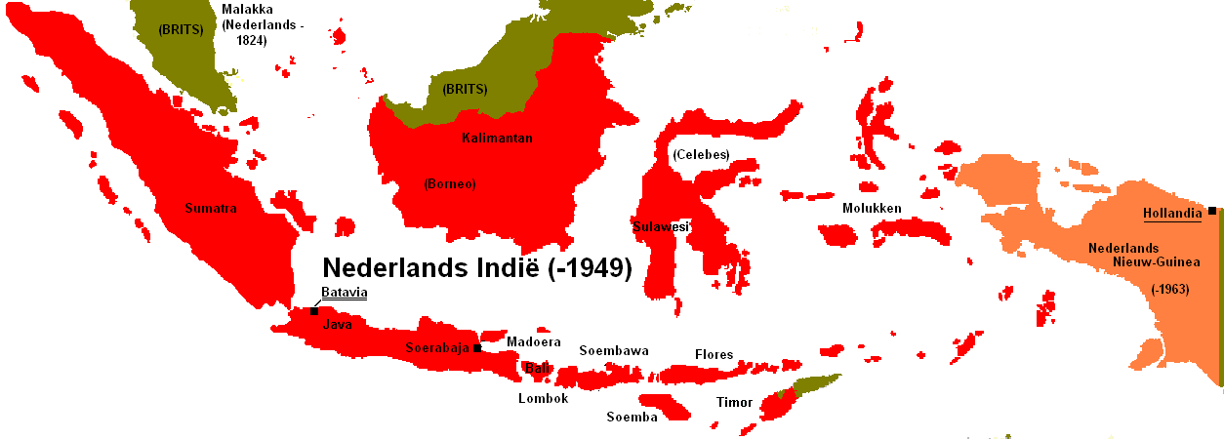
Indonesia
Dutch colony until 1949
Sukarno, intellectual and bourgeois-nationalist, founded multi-class PNI (Indonesia National Party)
Sukarno was not a Communist, but a proponent of Indonesian national autarchy
Began building nationalist movement during Japanese occupation, 1942
1945-1949 led national liberation struggle against Dutch

Slide 33

Summary
Independence forces had to create nationalism out of colonial mentality
Bourgeois-nationalist and anti-capitalist/anti-imperialist sensibilities were always mixed, creating complex array of political parties
Post-revolutionary leaders ruled through control over bureaucracy and claiming the symbolic mantle of revolutionary nationalism
Had to navigate both the complex array of political ideologies behind the nationalist movement and Cold War diplomacy

Slide 34
Part Three: Third World Internationalism

Slide 35
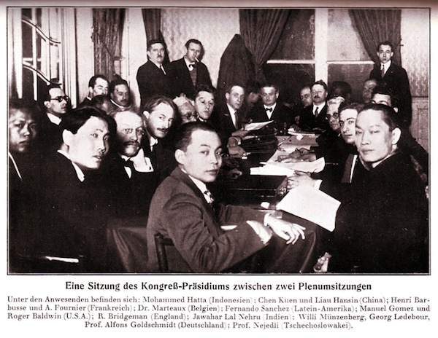
Brussels, 1927
Deliberately chose the most notorious site of colonial exploitation
“League Against Imperialism” deliberate contrast to “League of Nations” for shameful mandate system
Delegates were anti-imperialist nationalists and Communists

Slide 36
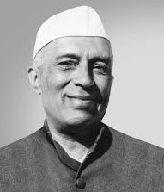

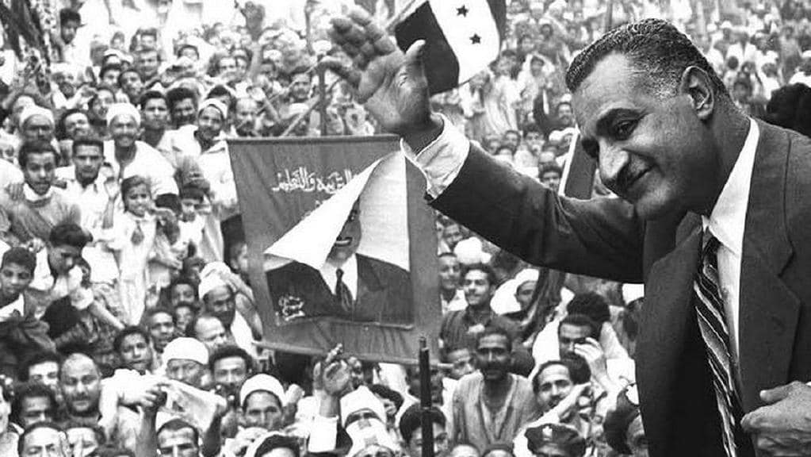
Leaders of Third World Nationalism
Jawaharlal Nehru, Sukarno, Gamal Abder Nasser Hussein
Leaders of independence struggles became symbols of the nation
Non-Communist or anti-Communist
Refused to kowtow to Washington
Argued end of “formal colonialism” did not mean end of economic dependence and underdevelopment
Willing to enact policies deemed “socialist” or “communist” by the first world, such as land reform or nationalization of vital resources

Slide 37
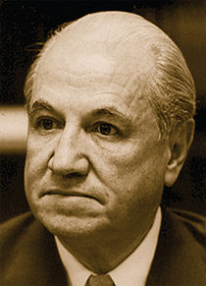
ECLA/CEPAL
United Nations Economic Commission on Latin America and the Caribbean founded in 1948
Former Argentine central banker Raúl Prebisch wrote the “Havana Manifesto” in 1949
Posited “deteriorating terms of trade” for Third World exports on world market
Solution: Foreign Aid and strategic protection of crucial industries

Slide 38
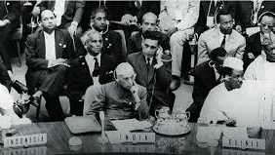
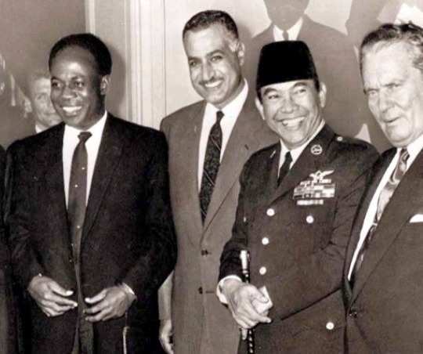
Bandung, 1955
Big figures: Nasser, Nehru, Sukarno, Nkrumah, Zhou Enlai
Established idea of Non-Aligned Movement (NAM)
Decided to use the United Nations to secure greater colonial liberation and economic development
NAM mostly meant “Afro-Asian” unity in this period

Slide 39
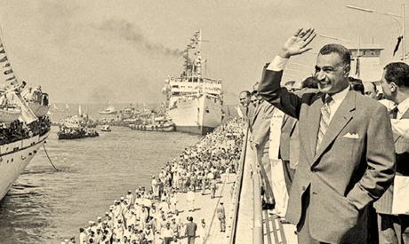
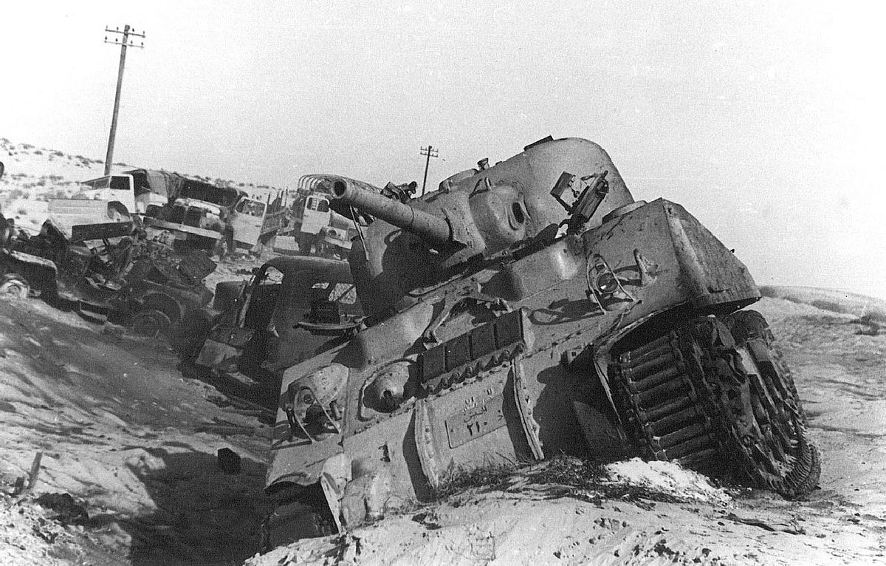
Nasserism
Cairo became a focal point of inter-Third World cooperation, especially “Afro-Asian solidarity”
Played US and USSR off one another for aid
Support for other anti-colonial movements alienated capitalist powers
Veering toward USSR encouraged socialist policies, such as nationalization of Suez Canal

Slide 40
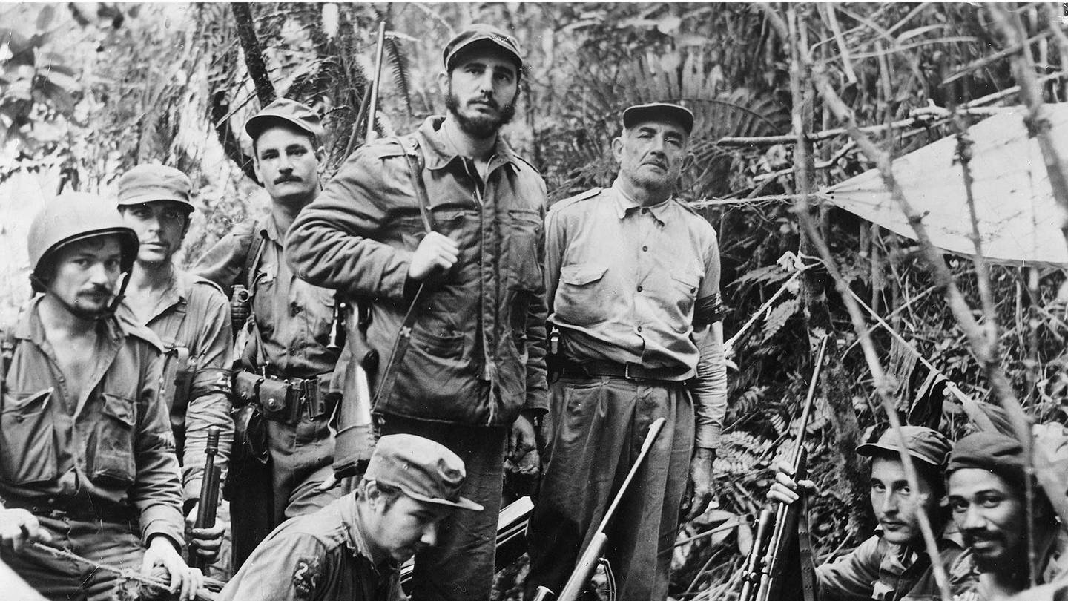
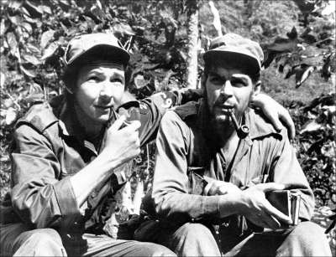
Castroism
Castro was a Cuban nationalist and middle class intellectual, admirer of pan-Latin Americanist Jose Marti
“Foco” theory, an extreme version of “vanguardism” in which small groups of revolutionary leaders would create (rather than gain leadership over) mass revolutionary struggles
Before 1959/60, Castro actually had wide support among US liberals

Slide 41


Che Guevara
Cuban Revolution became new symbol of international Third World Revolution
Origin of “Third World Marxism”
Che symbolized spread of “focoismo” to other places, including Congo and Bolivia

Slide 42

Havana, 1966
Added Latin America to “Afro-Asian” solidarity movement
Cuban Revolution, Fanon’s theory of revolutionary violence dominated conference
Mostly denounced Third World internationalism without real support for armed insurrection

Slide 43


Gender and National Liberation
Women crucial to protest movements and guerilla warfare
Rhetoric of freedom from enslavement easily extends to patriarchy
Yet national unity coalitions often include the most conservative and traditionalist segments of the nation
Raised complicated questions of transnational alliances with Western women’s movements

Slide 44
Summary and Conclusions
At the beginning the Third World movement tried to form a bloc to more successfully navigate Cold War diplomacy
Confluence of multi-party national unity coalitions and Cold War balancing act tended to reproduce “convergence,” a third way between Communism and capitalism
Frustration with lack of real economic development and CIA interventions fueled transition to transnational anti-imperialist guerrilla struggle
Language of national liberation would provide the conceptual framework for 1960s radicalism

